Slide 1

Access to Grants and Funds:
Parish & Town Council Borrowing
Shafi Khan
Local Government Funding Policy Team
Ministry of Housing, Communities and Local Government
APRIL 2019

Slide 2

What is parish and town council borrowing?
The Local Government Act 2003 enables parish councils to borrow capital monies to fund infrastructure and capital projects
All applications to borrow must first be approved by the Secretary of State for the Department for Communities and Local Government
We check all applications to ensure councils have appropriate public support and robust plans to pay off the loan
Important to be transparent when planning to take out a loan

Slide 3
What is the borrowing process?
(1)
NALC
Engage with your NALC County Association representative early on for advice
(2)
RESIDENTS
Engage with your residents early on, particularly if a precept increase is involved
(3)
NALC
Submit full application to your NALC County Association for checking & endorsement
(6)
PWLB
Apply to PWLB to draw-down the loan in whole or stages, within the 12 month approval
(5)
DCLG
We aim to provide a response within 15 working days of all the required evidence being submitted
(4)
DCLG
Submit full application to DCLG’s Local Government Funding Policy Team for approval

Slide 4
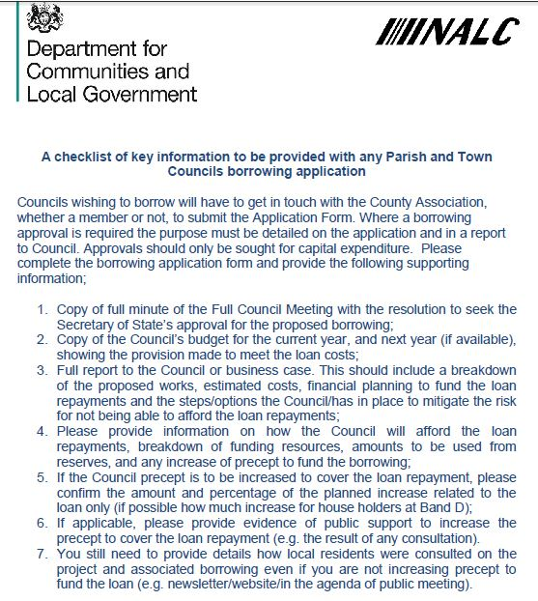
What do we look for in a borrowing application?
Resolution to borrow
Budget
Report to Council / business case
Loan affordability
Precept increase
Precept increase survey / public support
General project consultation

Slide 5

1. Resolution to borrow
It was resolved to apply for a loan.
It was RESOLVED to seek the approval of the Secretary of State for Housing, Communities and Local Government to apply for a PWLB loan of £100,000 over the borrowing term of 25 years for the village hall refurbishment.
Not Quite Right
RIGHT

Slide 6
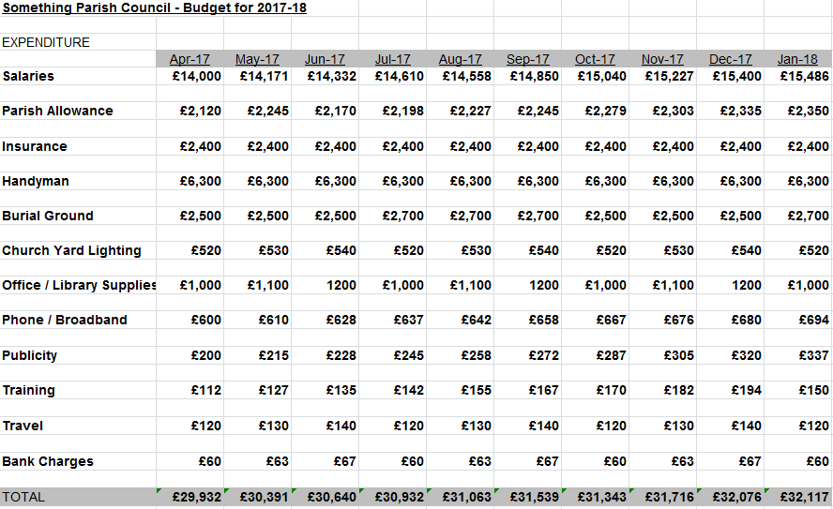
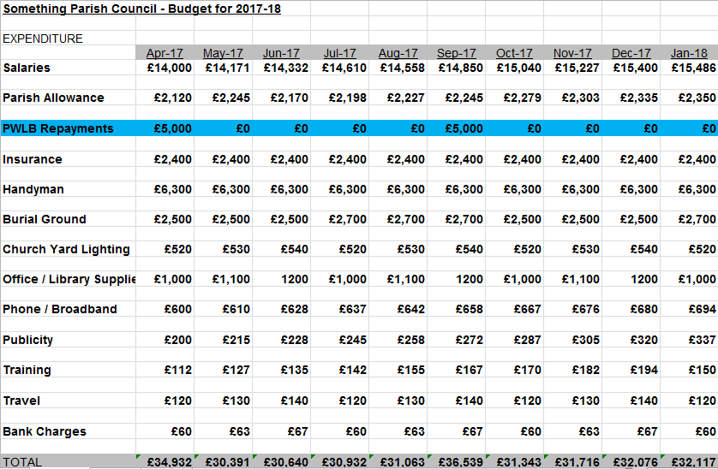
2. Budget
Not quite there. No loan repayment provision included.
Definitely there. Loan repayment provision line included.
Optional? ….Cash-flow forecast table covering a number of years

Slide 7
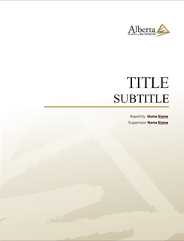
3. Report to Council / Business Case
Something
Parish
Council
Something
Parish
Council
Something
Parish
Council
Something
Parish
Council
Something
Parish
Council
Report to Council
Land
Valuation
Project Costings
Building Designs
Contractor
Estimates
Something
Parish
Council
Something
Parish
Council
Something
Parish
Council
Something
Parish
Council
Something
Parish
Council
Building Designs
Building
Valuation
Property Survey
Land
Valuation
Project Costings

Slide 8
4. Loan Affordability
Existing Loan Repayments
Income from Project
Plan B scenario
Efficiency Savings
Other income
How will you repay the loan?
Other Grants
Reserves
Existing Precept Budget

Slide 9
5. Precept increase
Percentage Increase
5%?
10%?
15%?
20%?
Monetary
Increase
£5?
£10?
£15?
£20?

Slide 10


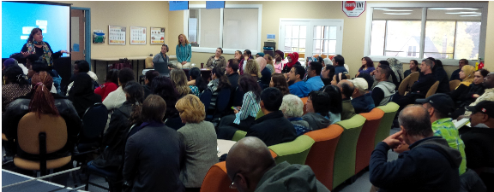
6. Council Tax precept increase survey / public support
Are you in FAVOUR of a council tax precept increase of an additional £XX a year for the purpose of the loan repayments for this project? YES / NO
Preferably a minimum of one month and must include a deadline.
Materials & results must carefully documented and submitted

Slide 11

7. General project consultation
Are you in FAVOUR of this project going ahead? YES / NO
The parish/town council wishes to seek the views/opinions/feedback from yourselves on this project and application. Please contact us direct by phone / email / post.
Ongoing dedicated website page showing updates on the project and associated borrowing approval application as they both progress.
Monthly/quarterly newsletters giving updates on the project and application.
Monthly/quarterly magazine articles giving updates on the project and application.
Local press/media coverage of the project.
Public open days and presentations to the residents on the project.

Slide 12
Further information
Government policy: https://www.gov.uk/government/publications/2010-to-2015-government-policy-local-government-spending/2010-to-2015-government-policy-local-government-spending#appendix-2-parish-and-town-council-borrowing-approval
Contact your local NALC County Association representative in the first instance, who will be able to send you the official application form and guidance including the Guide to Parish & Town Council Borrowing in England document.
Contact the Local Government Funding Policy Team: Parish.Borrowing@communities.gov.uk or 0303 444 3132 (Mr Shafi KHAN)
Seek advice early!

Slide 13

Any questions?

